Slide 1

Descriptive Statistics (Lecture)
Prof. Ah-Lian Kor
A.Kor@leedsbeckett.ac.uk

Slide 2
Outline
Descriptive Statistics
Basic Concepts
Measures of central tendency
Mode
Median
Mean
Measures of dispersion
Range
Variance or Standard Deviation
Others
Skewness
Curtosis

Slide 3
Descriptive Statistics
Descriptive Statistics is used to:
Describe data
Summarise data
Resource
http://study.com/academy/lesson/what-is-descriptive-statistics-examples-lesson-quiz.html

Slide 4
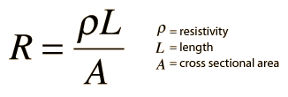
Basic Concepts
Dependent and independent variables
R is the dependent variable
Resistivity is a coefficient so it is a constant
L and A are independent variables

Slide 5
Basic Concepts
Types of data
Nominal scale (i.e. categorical data) – symbols or numbers are used to classify an object, person, or characteristics (examples: mobile devices, laptops, desktops, etc…)
Ordinal or ranking scale - objects in one category of a scale are not only different from the objects in other categories of that scale but also stand in some kind of relation to others (examples: the energy efficiency of 5th Gen Core Processors > 4th Gen Core processors > 3rd Gen Core processors)
Interval scale - Interval scales provide information about order, and also possess equal intervals (example: time on the 12-hr clock where there it has order, and the time interval for 2 to 4 p.m. is the same as 12 a.m. to 2 a.m.
Ratio scale – has the characteristics of the interval scale and has zero point as its true origin (example: measurement of the mass of two objects in ounces or grams. The ratio of the masses in ounces = ratio of the masses in grams)

Slide 6
Discrete versus continuous variables
Discrete - Finite number of values; can count
Continuous – Infinite number of values

Slide 7
Population and Sample
Population – it is an entire collection of things
Sample – it is a subset of a population

Slide 8
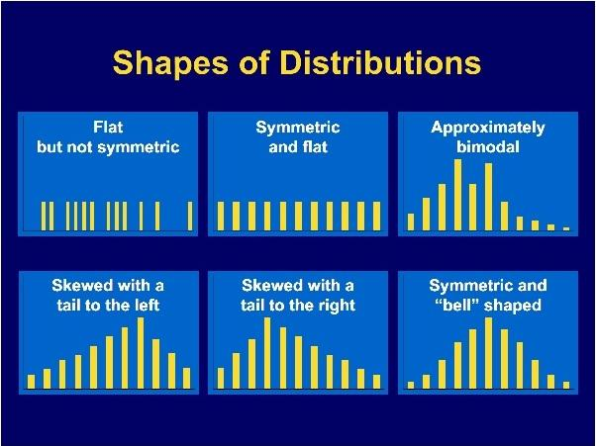
Shapes of frequency distribution are shown in the diagrams below:
Notes:
https://www.studyblue.com/notes/note/n/chapter-2-frequency-distributions/deck/5369037

Slide 9
Cumulative Frequency
Grades | Frequency | Cumulative Frequency
<40 | 10 | 10
40 ≤ x < 50 | 30 | 40
50 ≤ x < 60 | 50 | 90
60 ≤ x < 70 | 60 | 150
70 ≤ | 20 | 170
Table above shows the number of students for each grade. The third column cumulative frequency is created:
First value 10 = Frequency of the grade <40
Second value 40 = Frequency of 40 + Frequency 40 ≤ x < 50 (i.e. 10 + 30)
Third value 90 = Frequency of 40 + Frequency 40 ≤ x < 50 + Frequency 50 ≤ x < 60 (i.e. 10 + 30 + 50)
The rest follows
A cumulative frequency graph (sometimes called cumulative frequency distribution, CFD) is plotted.

Slide 10
Median Quartile and Percentile
Grades | Frequency | Cumulative Frequency | Cumulative Percentile (%)
<40 | 10 | 10 | 5.88%
40 ≤ x < 50 | 30 | 40 | 23.53%
50 ≤ x < 60 | 50 | 90 | 52.94%
60 ≤ x < 70 | 60 | 150 | 88.24%
70 ≤ | 20 | 170 | 100.00%
Table above shows an additional column, Cumulative Percentile or (%):
The sample size, n, is 170
The values for Cumulative Percentile = (Cumulative Frequency/n) *100%
A cumulative percentile graph is plotted.
Notes:
http://www.ehow.com/how_8784703_construct-percentile-graph.html

Slide 11
Measures of Central Tendency (Mode, Median, Mean)
The measures of central tendency are provided by the values of mode, median, and mean

Slide 12
Mode
The most common score is mode
Scores: 1, 2, 3, 5, 5, 5, 6, 1, 1, 1, 1, 2, 8, 9
Mode is: _______

Slide 13
Mean
Score | Frequency | Total Score
1 | 55 | 55
2 | 100 | 200
3 | 120 | 360
4 | 30 | 120
5 | 200 | 1000
Grand Total | 505 | 1735

Slide 14
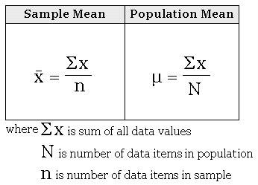
Mean (aka average)
Mean = 1735/505
= 3.44

Slide 15
Range
Range = maximum value – minimum value for a variable
Look at next table
Find the range for all the numeric columns

Slide 16
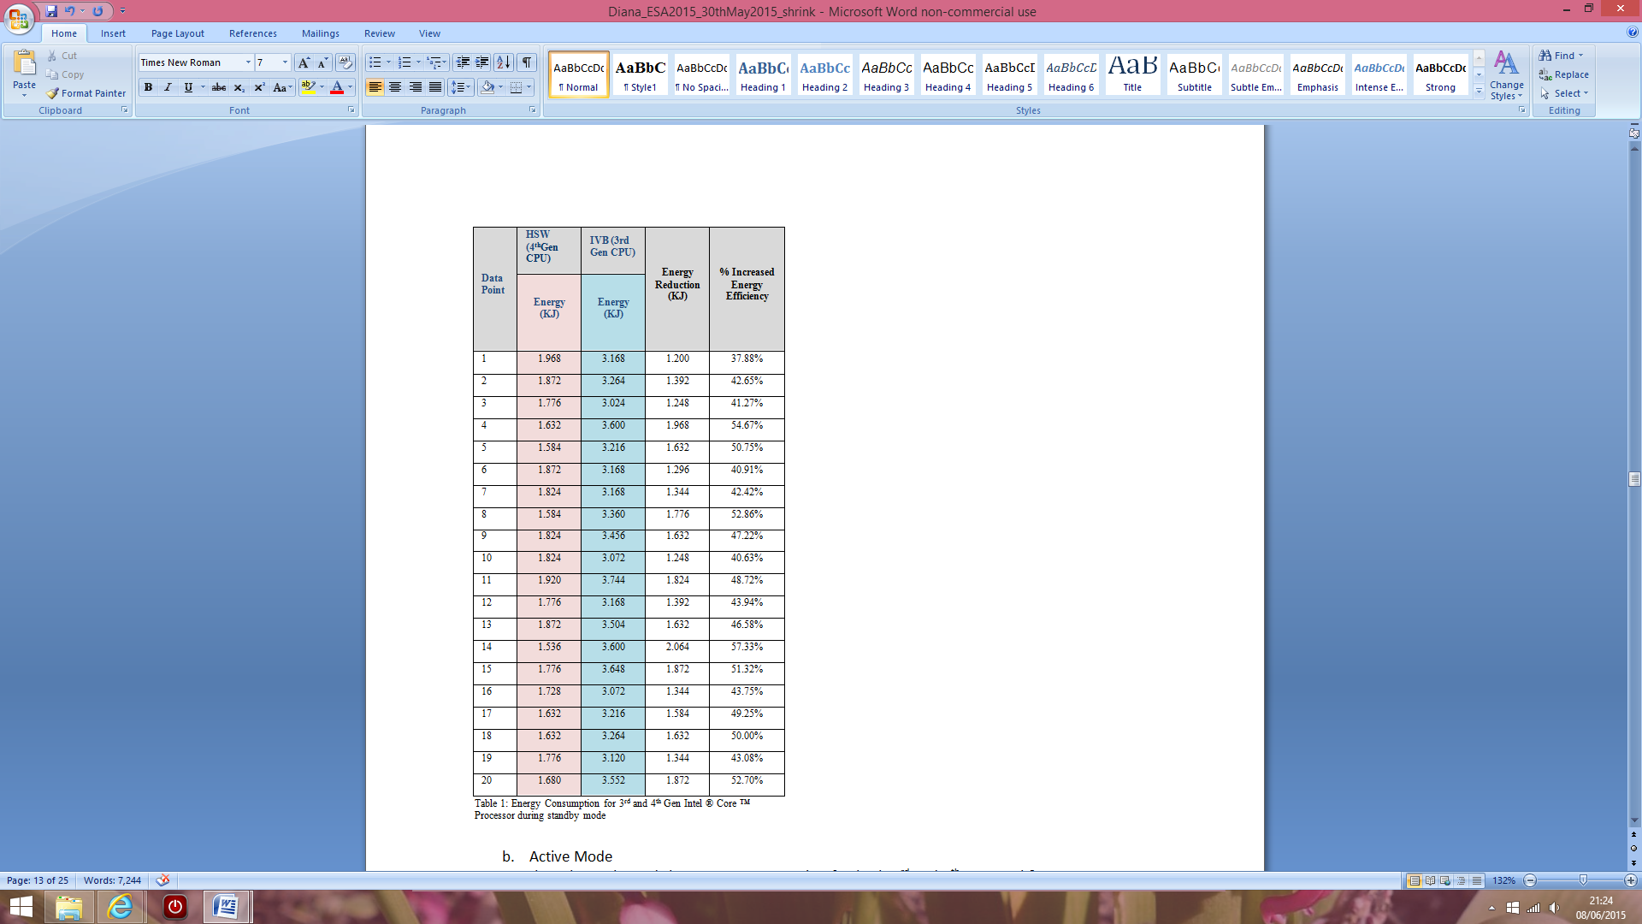
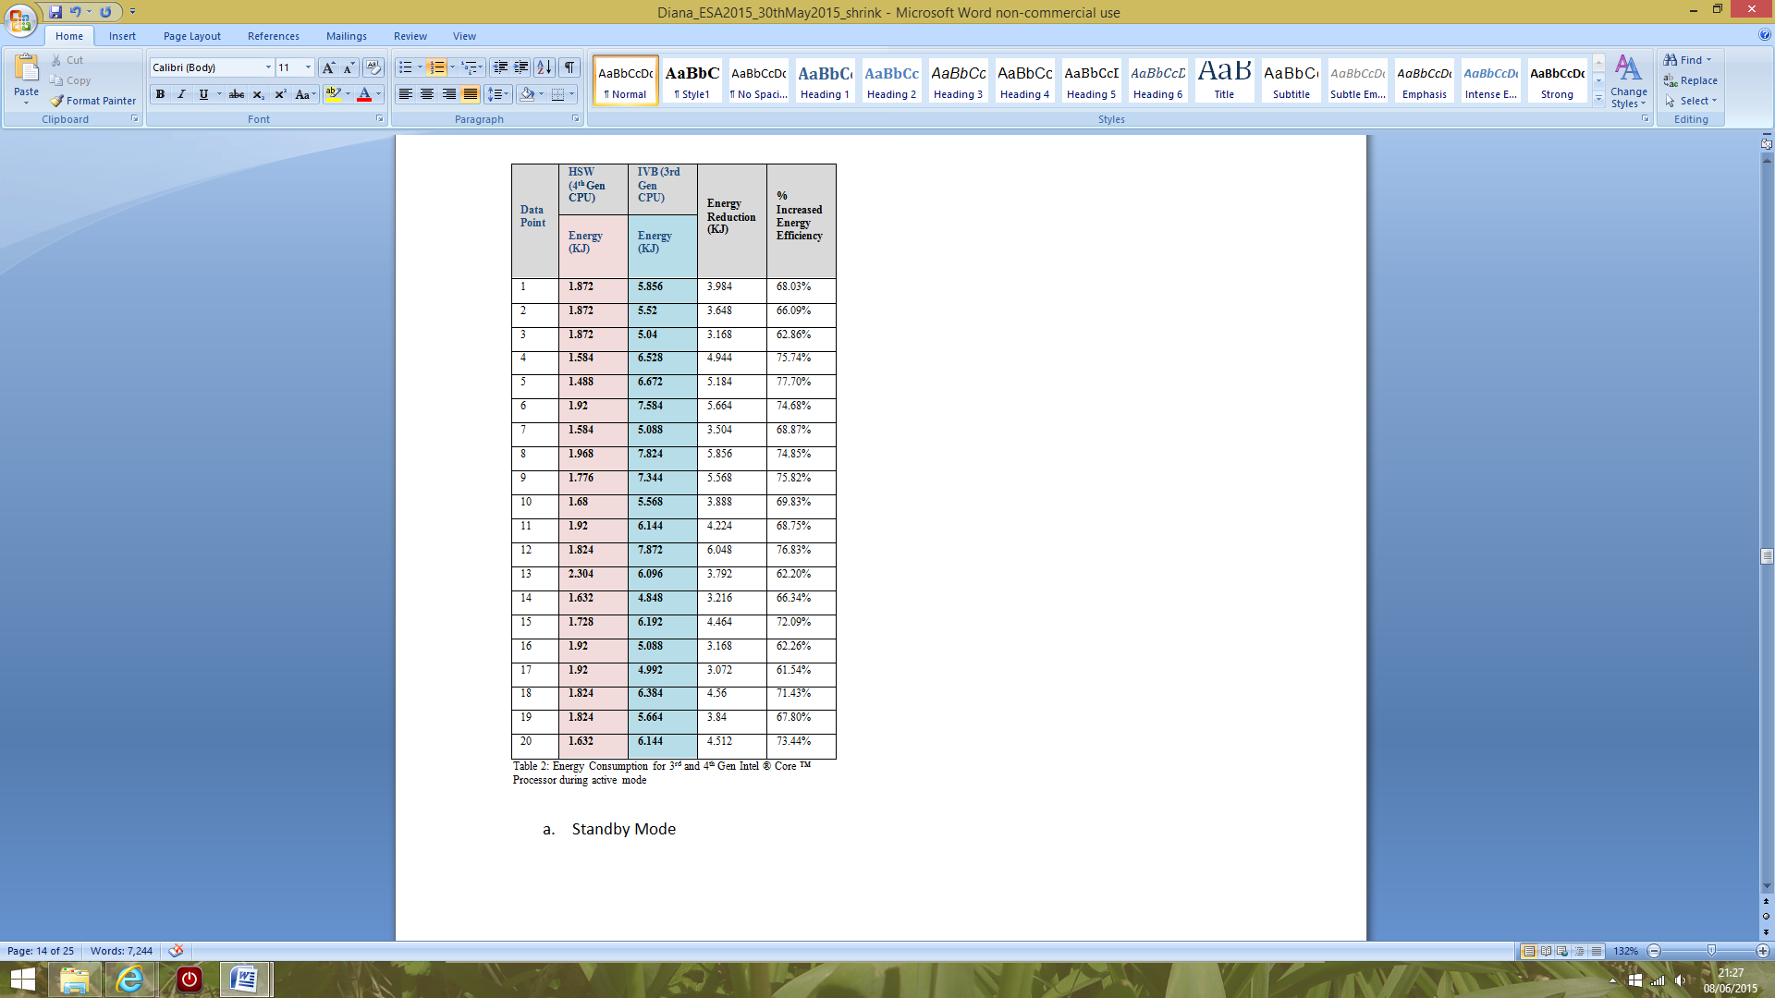

Slide 17
Ratio or % Increase/Decrease
Look at the next tables
Take the lowest value in a column as the denominator. Divide all the values in the column by the lowest value
For example, in the first table, the lowest value is 0.36 (for Internet Explorer 9). All the values in the column are divided by 0.36 and you will obtain the new ratio column. The ratio column gives you a value compared to IE (if >1, then greater than IE; =1 then equal to IE; < 1 smaller than IE)

Slide 18
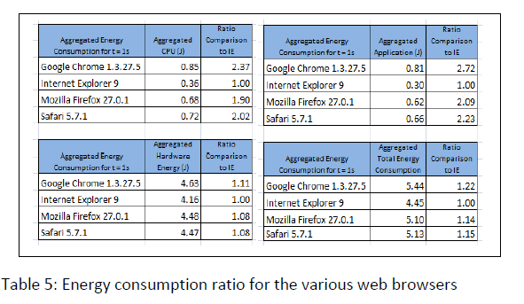

Slide 19
Median
Arrange the values in ascending order. Find the middle of the sorted list. Notes: https://www.mathsisfun.com/definitions/median.html . Find the median for the following lists of numbers:
3,5,6,2,3,6,7,8,9,3,4,5,2
3,5,6,2,3,6,7,8,9,3,4,5
1, 5, 7
n=3
(n+1)/2 = 2
n = 2 will be the median number -> 5
1, 5, 6, 7
n = 4
(n+1)/2 = 2.5
Median = (5 +6)/2

Slide 20
Mean and Median for Frequency Table
Table (look at next slide).
An original table with score and frequency is given. You will have to add two new columns (i.e. total which is equal to the multiplication of score and frequency) and this is for the mean.
n = 505
Mean = 835/505 = 1.653
(n+1)/2 = 253. This means that the middle number is 253.
Check the table. 253rd score is 3. So the median is 3.
Look at this video https://www.youtube.com/watch?v=t2BSuUXfftA
Graph – look at percentile graph (50%)
Median, Lower and Upper quartile https://www.onlinemathlearning.com/percentile.html#:~:text=The%20following%20cumulative%20frequency%20graph,40%20students%20in%20a%20test.&text=Solution%3A,50%25%20of%20the%20total%20frequency.&text=From%20the%20graph%2C%2020%20on,44%20on%20the%20horizontal%20axis.
https://www.youtube.com/watch?v=zlADtyhKIBY

Slide 21
Find the mean and median
Score | Frequency | Total Frequency x Score | Cumulative Frequency
1 | 55 | 55 | 55 1-55
2 | 100 | 200 | 155 56-155
3 | 120 | 360 | 275 156-275
4 | 30 | 120 | 305 276-305
5 | 200 | 100 | 505 306-505
Grand Total | 505 | 835

Slide 22
Measures of Dispersion (Range, Variance and Standard Deviation)

Slide 23
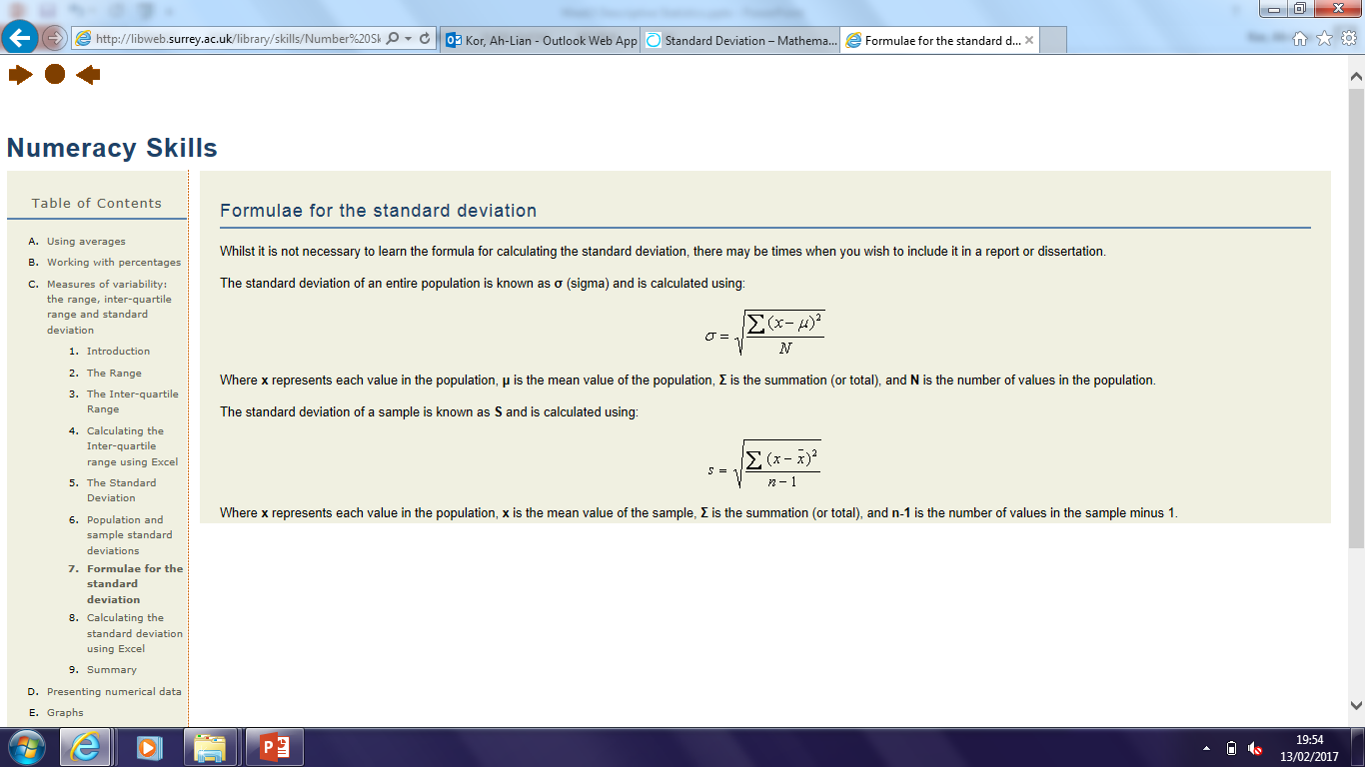
Standard Error (or Standard Deviation for a population and sample for ungrouped numbers)

Slide 24
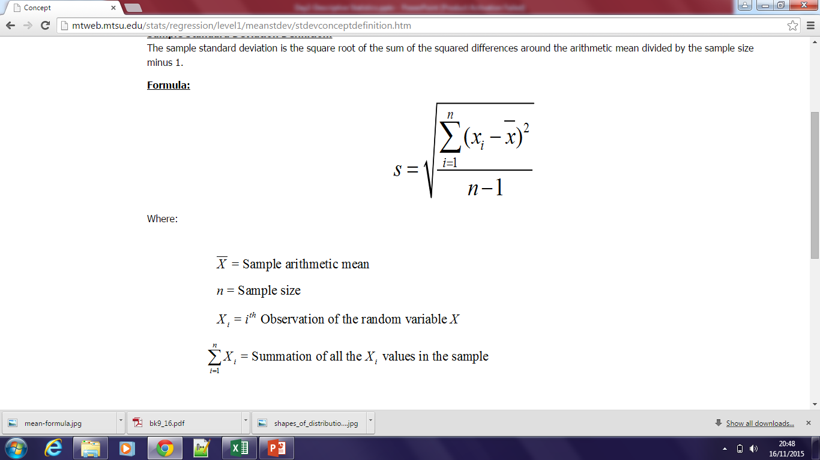
Standard Error (or Standard Deviation for a sample)

Slide 25
Standard Deviation and Variance
Example 1: Ungrouped data - Manual Step by Step
Find the standard deviation for the following population:
1, 5, 6, 8, 10 (See formula in the excel file, Std deviation ungrouped.xlsx)

Slide 26
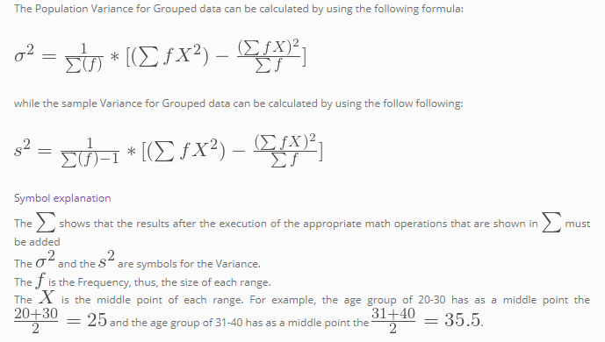
Standard Deviation and Variance for Grouped Data
Example 2: Manual Step by Step (https://estatistics.eu/what-is-statistics-standard-deviation-and-variance-for-grouped-data/ )

Slide 27
Variance and Standard Deviation step by step
Example 2 for Grouped Sample. Note only the first two columns are given. You will have to add 4 new columns.
Mid-class value is the middle value of each interval. (see the formula in the excel file, Std deviation grouped.xlsx)

Slide 28
Standard Deviation (Step by Step resources)
https://www.mathsisfun.com/data/standard-deviation-formulas.html
http://www.mathsisfun.com/data/standard-deviation.html
http://www.dummies.com/education/math/statistics/how-to-calculate-standard-deviation-in-a-statistical-data-set/
https://revisionmaths.com/gcse-maths-revision/statistics-handling-data/standard-deviation

Slide 29
Others (Skewness and Curtosis)
http://www.itl.nist.gov/div898/handbook/eda/section3/eda35b.htm
https://help.gooddata.com/display/doc/Normality+Testing+-+Skewness+and+Kurtosis

Slide 30
How to interpret Skewness and Curtosis?
Skewness of Distribution (Rules of Thumb)
https://help.gooddata.com/display/doc/Normality+Testing+-+Skewness+and+Kurtosis
If skewness is less than -1 or greater than 1, the distribution is highly skewed.
If skewness is between -1 and -0.5 or between 0.5 and 1, the distribution is moderately skewed.
If skewness is between -0.5 and 0.5, the distribution is approximately symmetric.

Slide 31
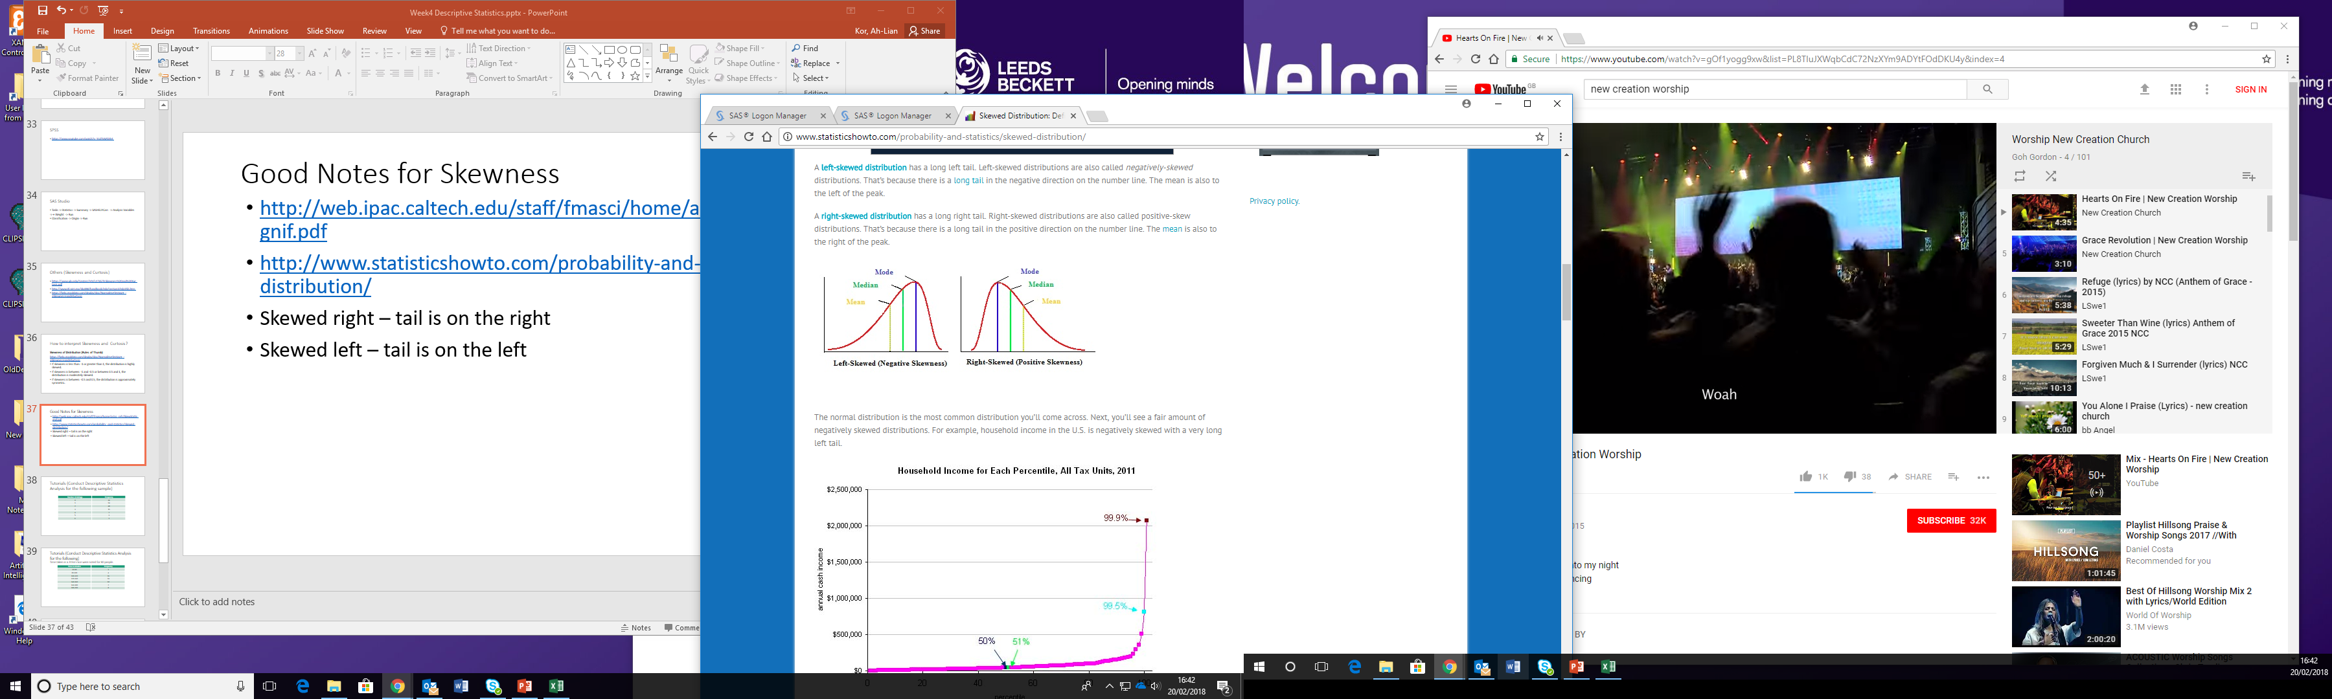
Good Notes for Skewness
http://www.statisticshowto.com/probability-and-statistics/skewed-distribution/
Skewed right – tail is on the right (+ value)
Skewed left – tail is on the left (- value)

Slide 32
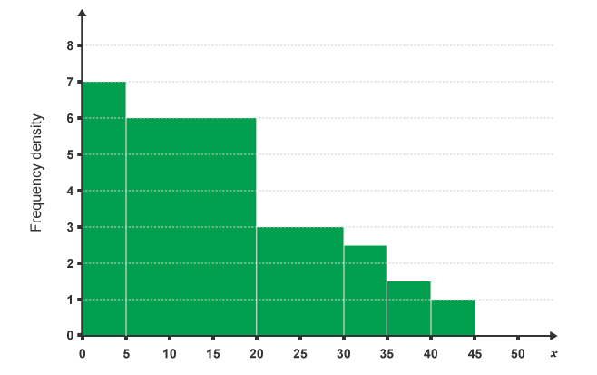
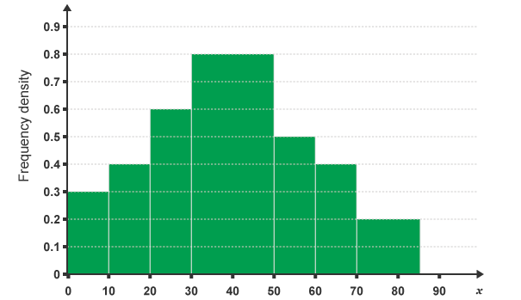
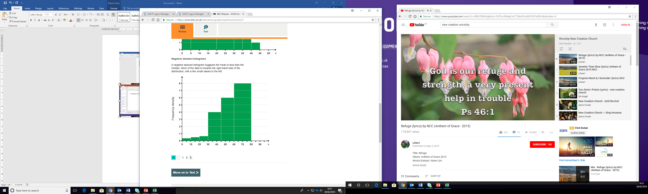
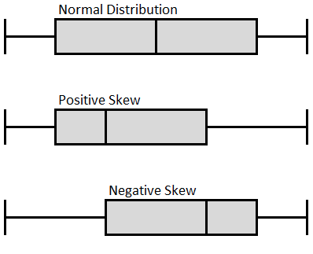
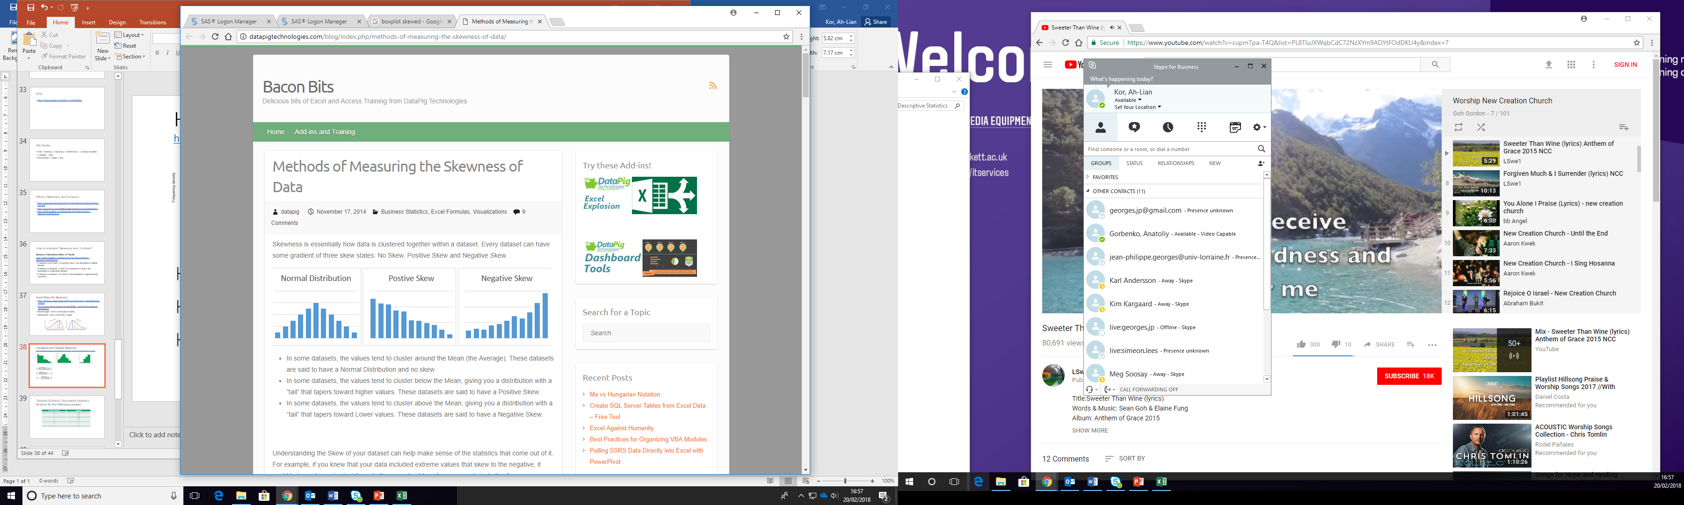
Histogram and Boxplot Skewness

Slide 33
Kurtosis
http://www.statisticshowto.com/probability-and-statistics/statistics-definitions/kurtosis-leptokurtic-platykurtic/
https://www.spcforexcel.com/knowledge/basic-statistics/are-skewness-and-kurtosis-useful-statistics
“Kurtosis is the degree of peakedness of a distribution” – Wolfram MathWorld
“We use kurtosis as a measure of peakedness (or flatness)” – Real Statistics Using Excel

Slide 34
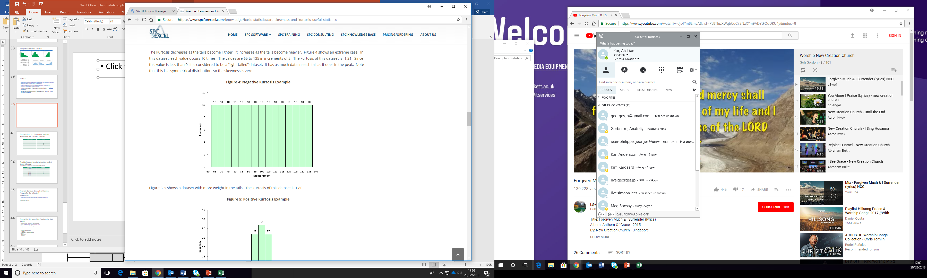
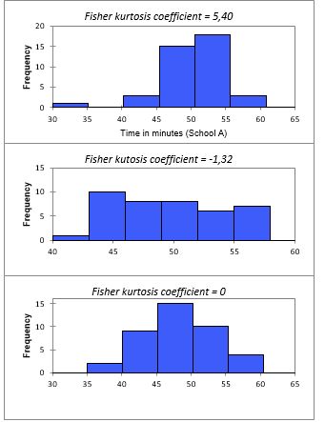
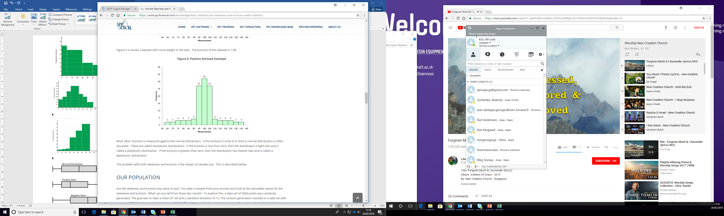
https://help.xlstat.com/customer/en/portal/articles/2752199-skewness-and-kurtosis-in-excel?b_id=9283
https://www.spcforexcel.com/knowledge/basic-statistics/are-skewness-and-kurtosis-useful-statistics

Slide 35
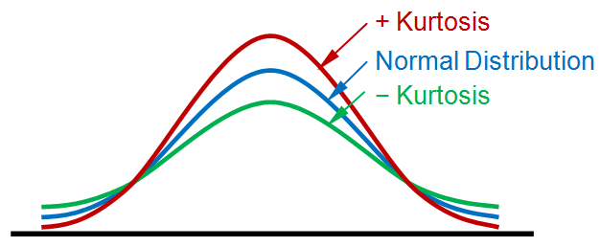
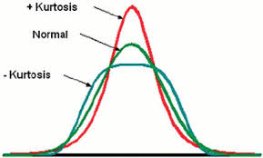
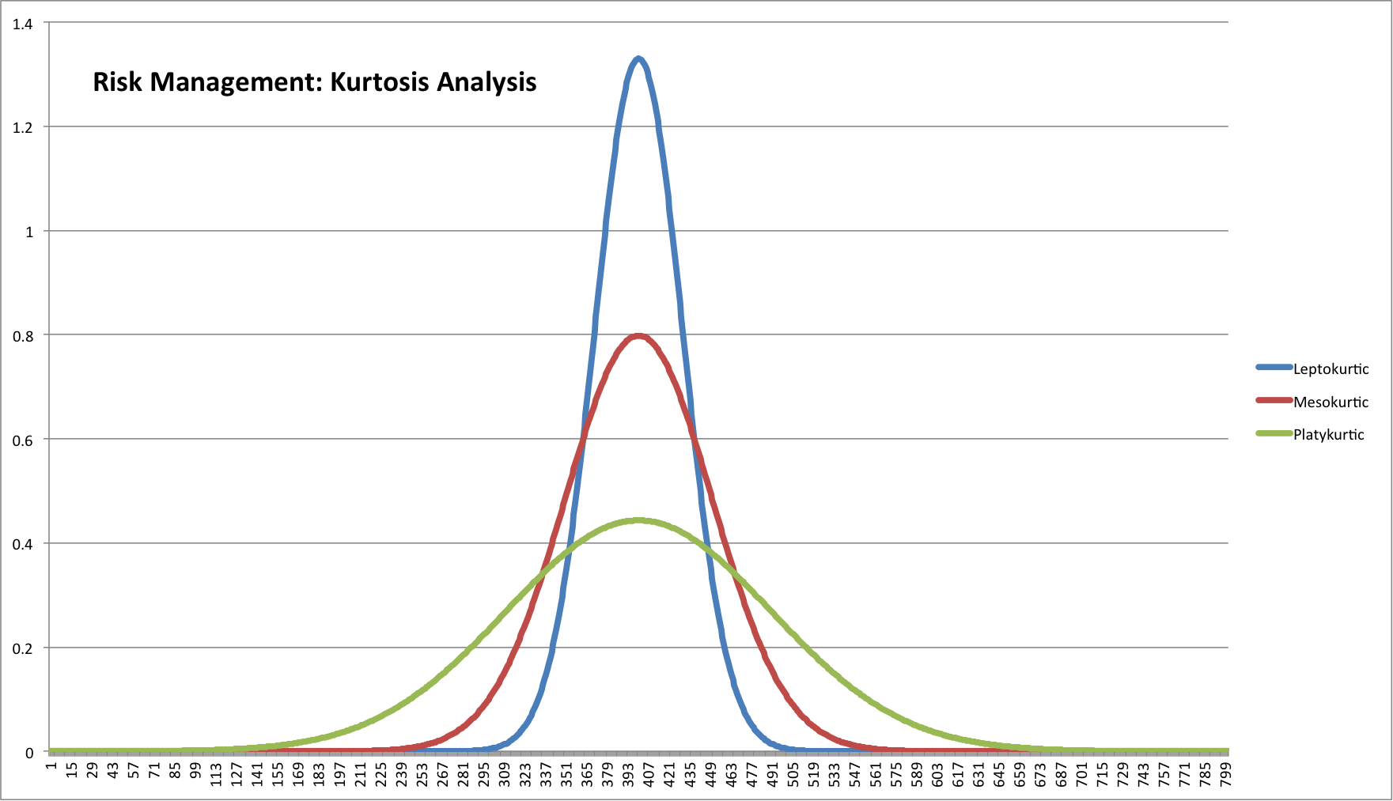

Slide 36
Kurtosis https://www.itl.nist.gov/div898/handbook/eda/section3/eda35b.htm
To indicate whether a dataset is normal or not
Heavy (fatter) -tailed relative to normal distribution – high kurtosis, more outliers
Light (thinner) -tailed relative to normal distribution – low kurtosis, low outliers
Standard normal distribution – kurtosis equals 0
How to interpret kurtosis https://corporatefinanceinstitute.com/resources/knowledge/other/kurtosis/; https://www.investopedia.com/terms/k/kurtosis.asp; https://codeburst.io/2-important-statistics-terms-you-need-to-know-in-data-science-skewness-and-kurtosis-388fef94eeaa

Slide 37
More Sample Exam Questions (Conduct Descriptive Statistics Analysis for the following sample)
Number of siblings | Frequency
0 | 36
1 | 94
2 | 48
3 | 15
4 | 7
5 | 3
6 | 1

Slide 38
More Sample Exam Questions (Conduct Descriptive Statistics Analysis for the following) Time taken in a 20 km race were noted for 80 people.
Time in minutes | Frequency
60-80 | 1
80-100 | 4
100-120 | 26
120-140 | 24
140-160 | 10
160-180 | 7
180-200 | 8

Slide 39
More Self-Paced Exercises (Conduct Descriptive Statistics Analysis for the following)
Maternity Dataset
http://www.content.digital.nhs.uk/catalogue/PUB23255
Assignment Dataset

Slide 40
Additional Exercises for this week (Use Excel and/or Python)
Dataset Week 1 excel file (Testdata.xls) is obtained from http://www.princeton.edu/~otorres/Excel/
Measures of central tendency
Mode
Median
Mean
Measures of dispersion
Range
Variance or Standard Deviation
Others
Skewness
Kurtosis

Slide 41
Additional references
http://www.princeton.edu/~otorres/Excel/
https://www.dummies.com/software/microsoft-office/excel/how-to-use-excels-descriptive-statistics-tool/
http://www.open.ac.uk/socialsciences/spsstutorial/files/tutorials/descriptive-statistics.pdf
https://uk.mathworks.com/help/matlab/data_analysis/descriptive-statistics.html

Slide 42
The End

